Slide 1
Campus Placement Analyzer
Name: Kolhal Jayprakash Vinayak
Branch : IT

Slide 2
INTRODUCTION:
Campus Placement Analyzer is a data analytics project designed to help colleges and training institutes analyze student placement data.
The system evaluates student performance, placement statistics, company wise hiring trends, and training effectiveness.
The goal is to identify patterns, improve placement strategies, and provide actionable insights for both students and administration.

Slide 3
OBJECTIVE:
1) Data-Driven Decision Making :
Helps colleges move from guesswork to data-based placement strategies.
2) Improve Placement Percentage:
Identifies weak departments & skill gaps to increase overall placement success.
3)Early Identification of PIP Students:
Automatically detects students with CGPA below 6 for improvement programs.
4)Training Effectiveness Measurement:
Analyzes whether training hours & skill scores actually improve placement result.

Slide 4
5)Company Hiring Trend Analysis:
Shows which companies hire more, salary trends, and demand for specific role
6)Student Performance Benchmarking:
Helps students understand minimum eligibility criteria for top companies.
7)Better Salary Insights:
Analyzes correlation between CGPA, skills, and salary packages.
8) Supports Recruiters:
Provides structured student performance data for smarter hiring decisions.
9)Strategic Planning for Management:
Helps administration plan workshops, certifications, and training programs.
10)Predict Future Placement Probability:
(Advanced)Uses analytics to predict which students are most likely to get placed.

Slide 5
What Problem Are We Solving ?
1)Lack of Data-Driven Placement Strategy:
Helps colleges move from guesswork to data-based placement strategies
2) Low Placement Percentage:
Identifies weak departments & skill gaps to increase overall placement success.
3)Skill Gap Identification:
Institutes cannot accurately identify technical & soft skill gaps
4) No Early Warning System:
Students with low CGPA or poor performance are not identified early (No PIP tracking).

Slide 6
5) Unclear Company Hiring Trends:
No analysis of which companies hire more, roles offered, or salary
patterns
6) Ineffective Training Evaluation:
Difficulty in measuring whether training hours improve placement
outcomes.
7)Limited Insight for Recruiters:
Recruiters lack structured performance insights for better hiring decisions

Slide 7
Introduction of Numpy:
Numpy is advance library which is used to perform fast calculation with arrays and mathemathical operations.
Numpy also plays important role for data manipulation.
Numpy use for best performance of applications.

Slide 8
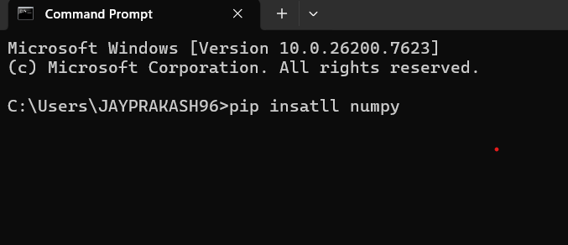
Installation of Numpy:
To run numpy program we need following setup.
Python Installed required.
Install Numpy.

Slide 9
Introduction of pandas:
To work with tabular form data(like excel sheet)
by using pandas we can read and write excel file.
It is use for clearing data(remove missing value,duplicate value
By using pandas we can easily analyze complex data.

Slide 10
Given dataset:
Pandas Installation:-
To install Pandas use following command:
cmd>pip install pandas
To work with Pandas and Excel File we need To fire following command:
cmd>pip install- -upgrade pandas openpyxl

Slide 11
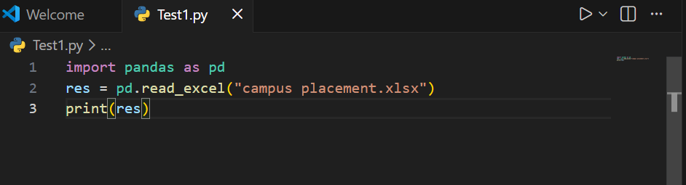
Accessing data from the given dataset:

Slide 12
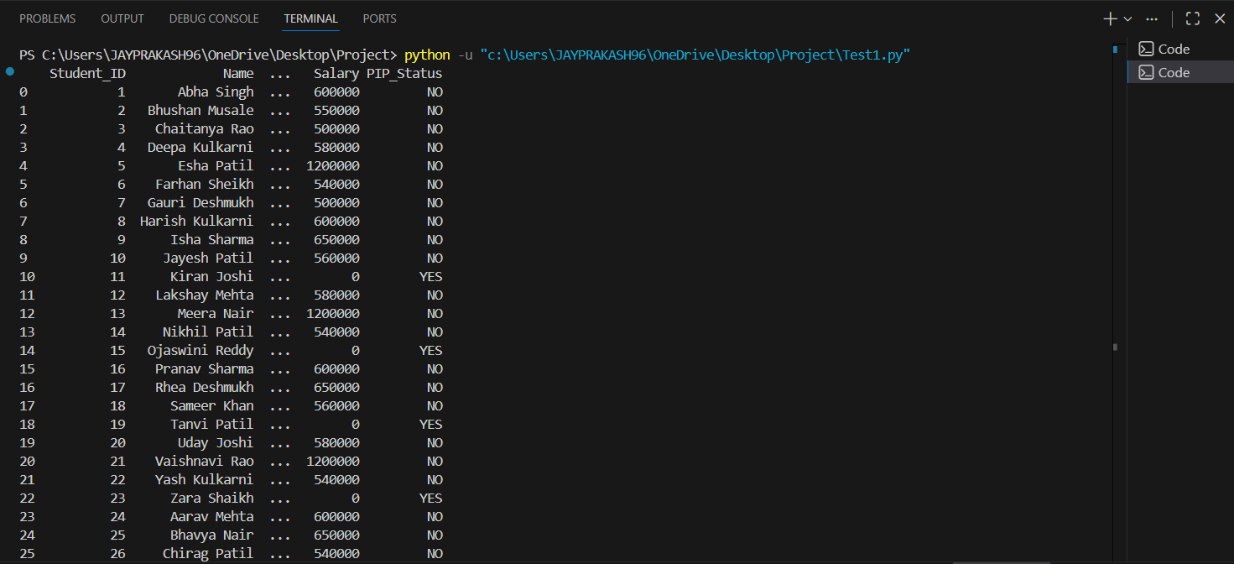
Output of the given dataset:

Slide 13
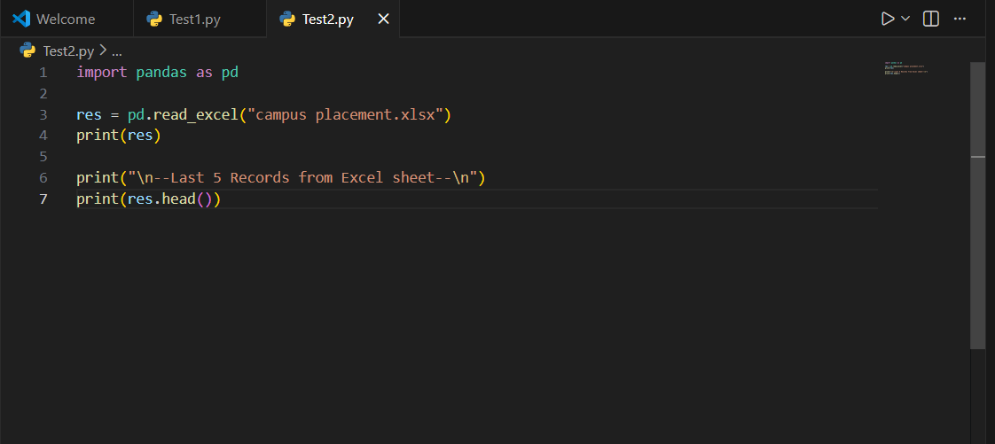
How to display top 5 record:

Slide 14
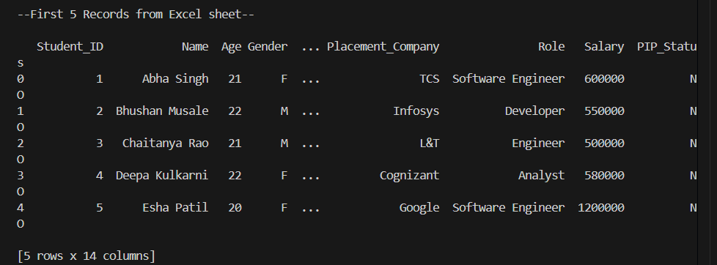
Output of top 5 record:

Slide 15
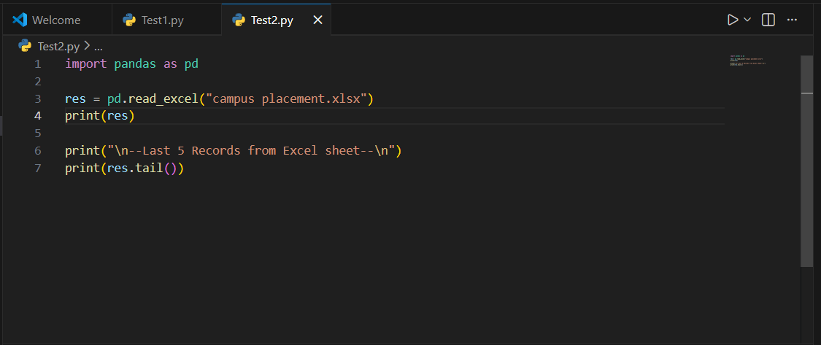
How to display last 5 record:

Slide 16
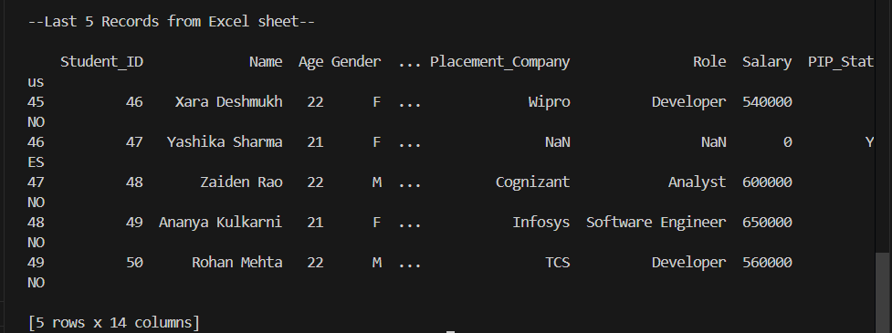
Output of the last 5 record:

Slide 17
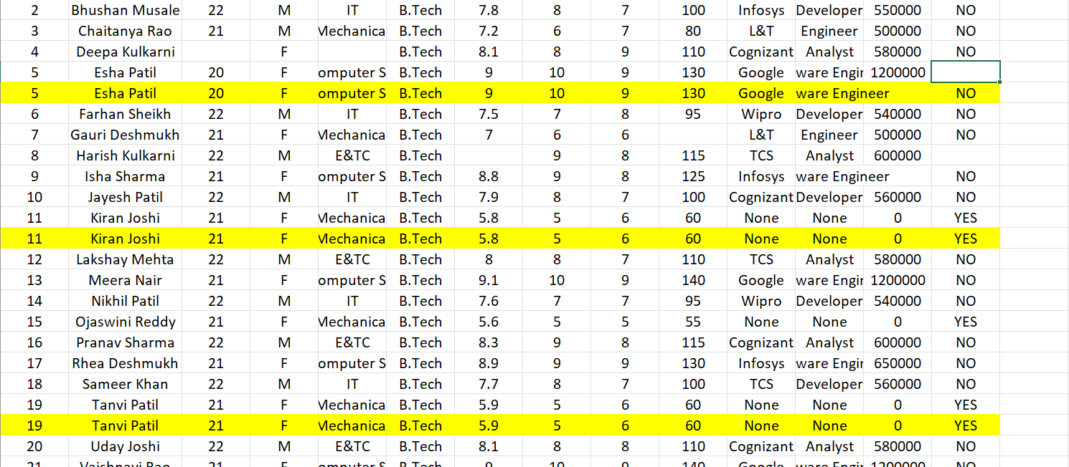
Duplicate value in given dataset:

Slide 18
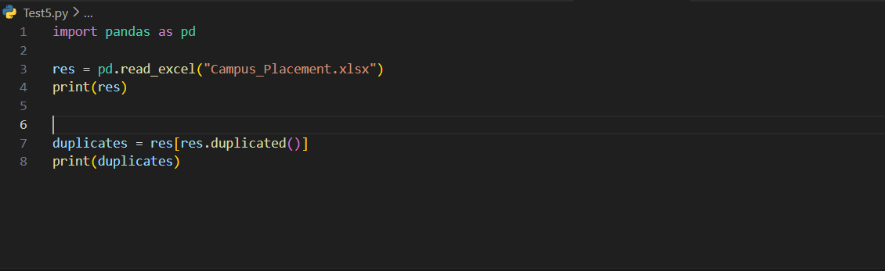
How to find duplicate value:
Duplicates method : It will Selects all duplicate rows from the DataFrame res and stores them in duplicate

Slide 19
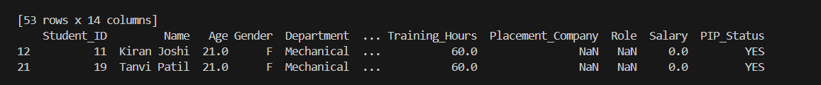
Output of duplicate value:

Slide 20
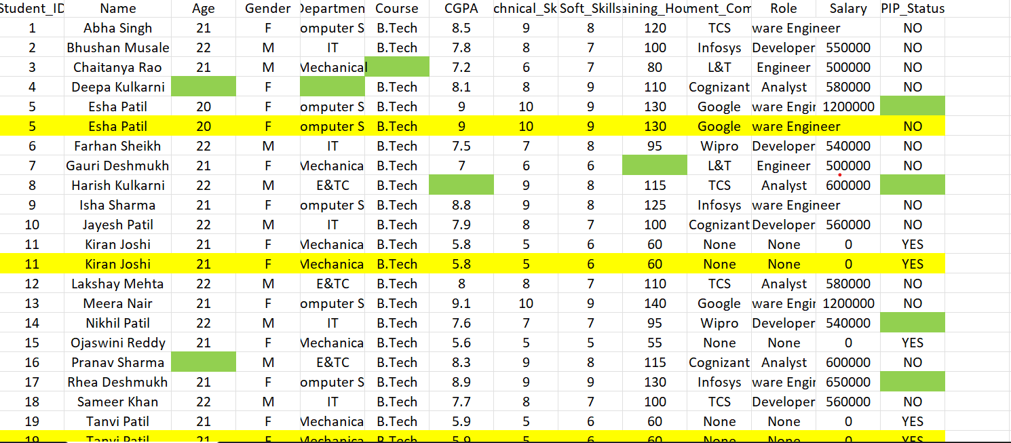
Missing value in given dataset:

Slide 21
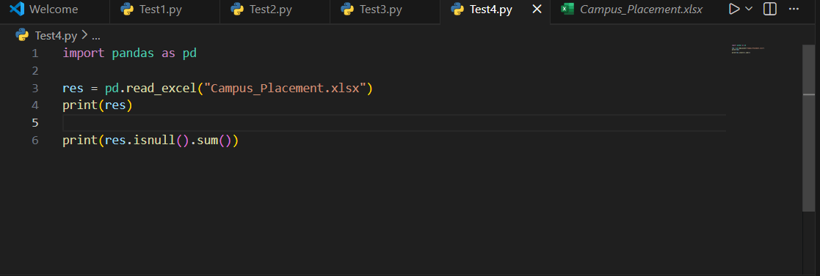
How to find missing value in given dataset:
Missing Value:Returns the number of missing (NaN) values in each column of the DataFrame res.

Slide 22
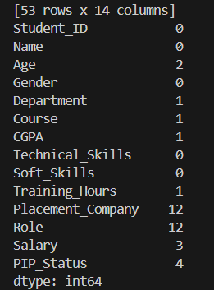
Output of Missing value:

Slide 23
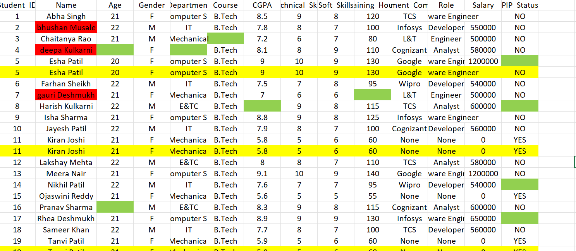
Handle Inconsistent Format(Text case):

Slide 24
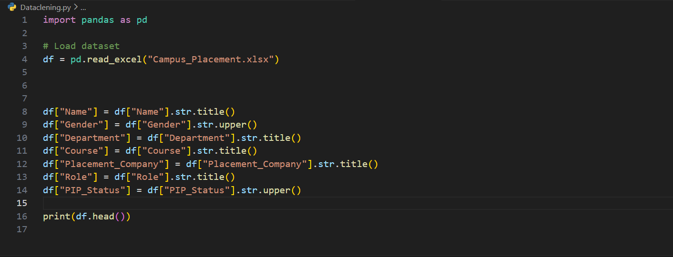
How to find inconsistent format(text case):

Slide 25
How to find inconsistent format(text case):
Data Cleaning:This code cleans the dataset by removing extra spaces and converting all text columns (like Name, Gender, Department, Company, Role, PIP_Status) into a consistent format such as Proper Case or UPPERCASE.

Slide 26
Output of inconsistent format data:

Slide 27
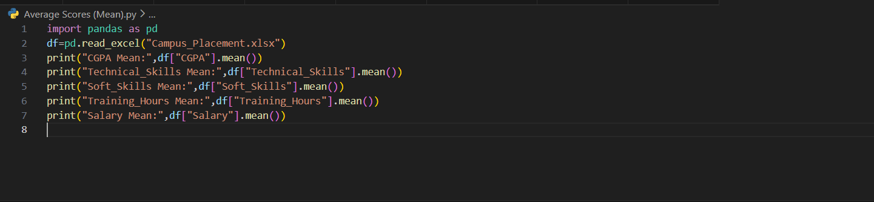
Average scores of CGPA,Technical_Skill,Soft_ Skill,Traning_Hour,Salary :
Average Mean:Mean is the average value calculated by adding all values and dividing by total number of students.

Slide 28
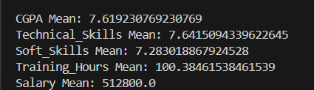
Output of Average Score:

Slide 29
Data Visualization:
Data Visualization:Visualization means showing data in the form of charts or graphs instead of numbers.
Bar Chart:A Bar Chart uses rectangular bars to compare different categories.
Line Chart:A Line Chart shows data using points connected by lines.
Pie Chart:A Pie Chart is a circle divided into slices.

Slide 30
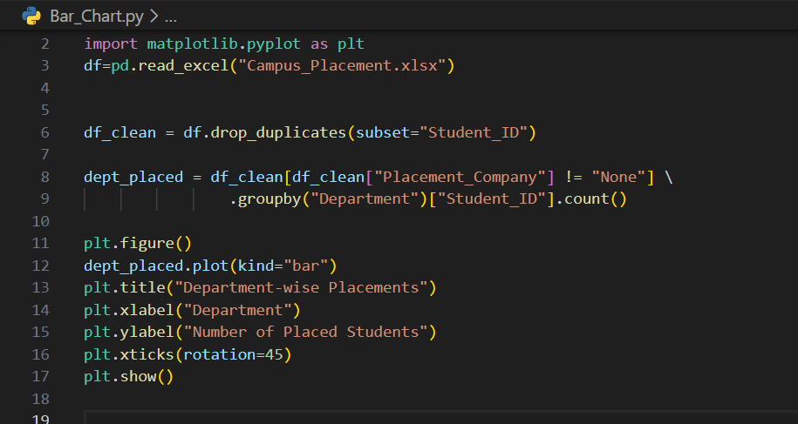
Bar Chart:
Bar Chart (Department-wise Placement):Shows which department has more placements.

Slide 31
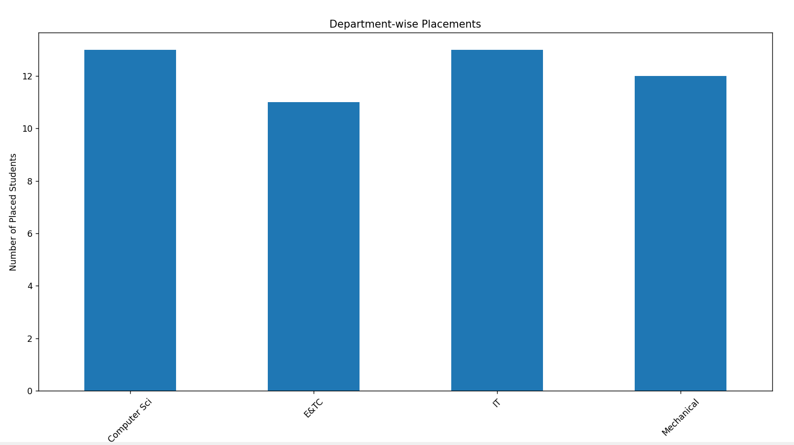
Output of bar chart:

Slide 32
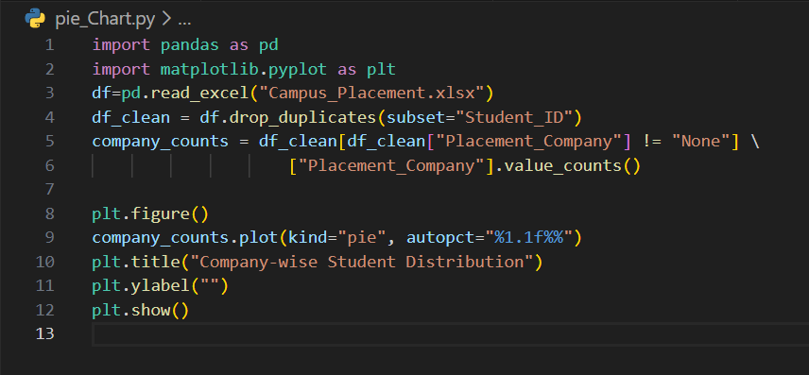
Pie Chart:
Pie Chart (Company-wise Distribution):Shows which company hired more students.

Slide 33
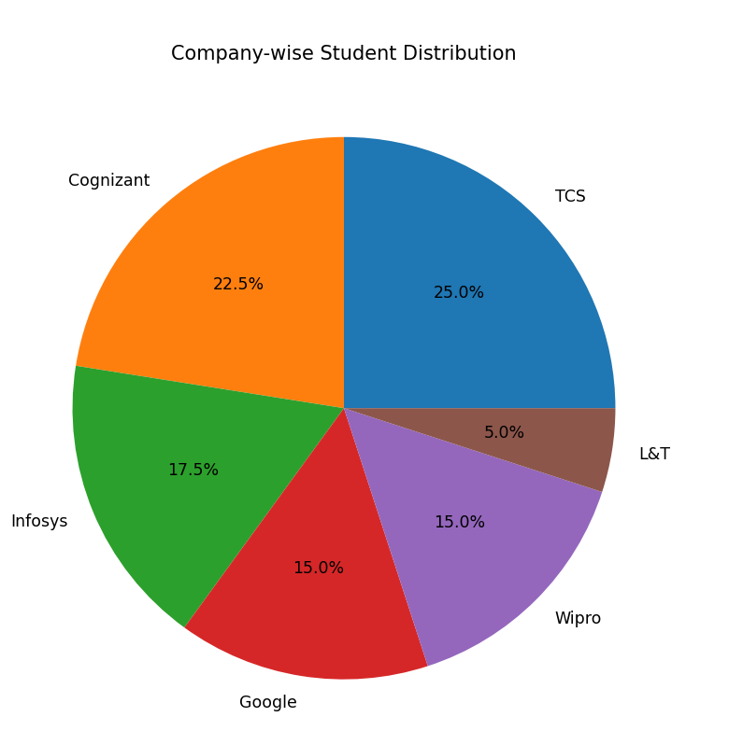
Output of Pie Chart:

Slide 34
Thank You

